Slide 1
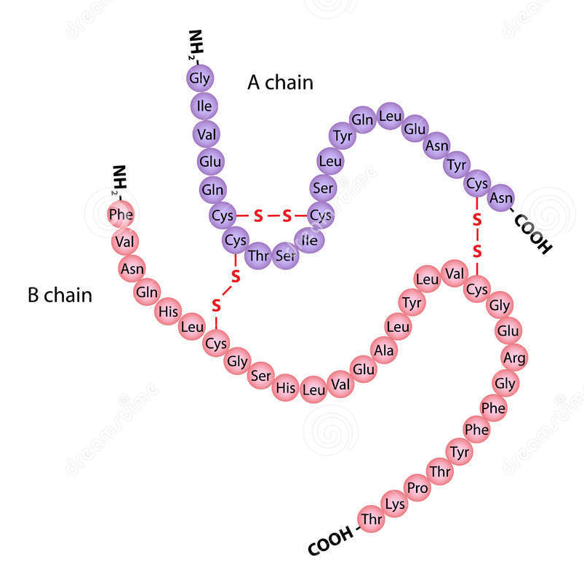
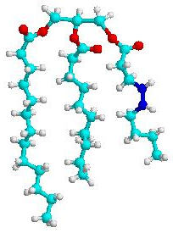
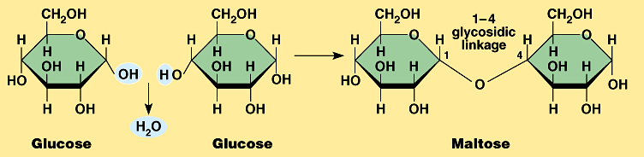
Chemicals of life
http://www.biotopics.co.uk/jsmol/alphabetaglucose.html#
IGCSE Biology

Slide 2
Water
Formula = H₂O
A good solvent – it dissolves many solutes
Used for transport – e.g. glucose in the blood
Useful for cooling – e.g. sweating
Used for support – e.g. turgid plant cells
Neutral pH – around 7.0
An important environment for organisms.

Slide 3
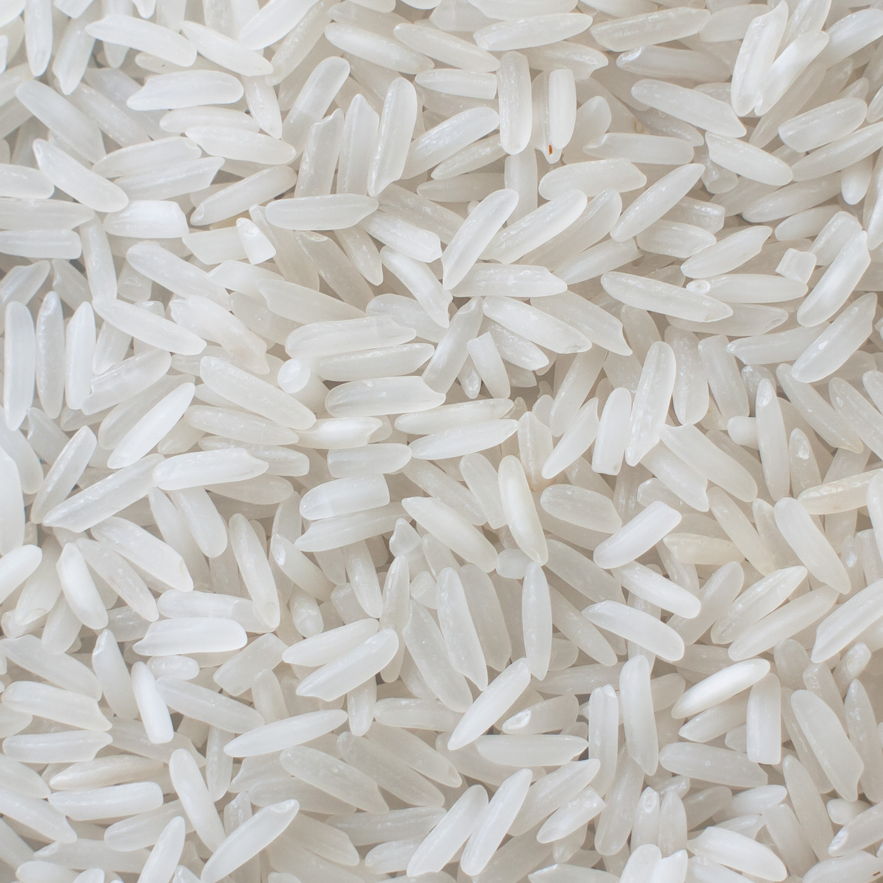
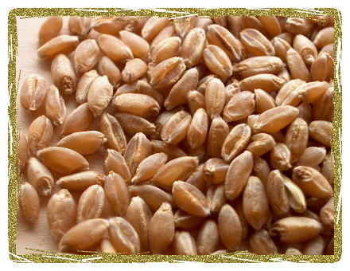
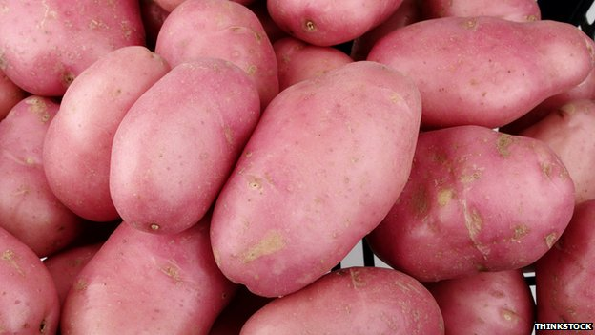
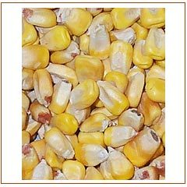
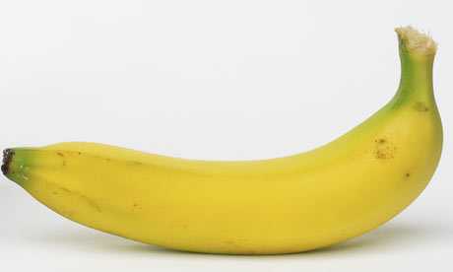
Carbohydrates

Slide 4
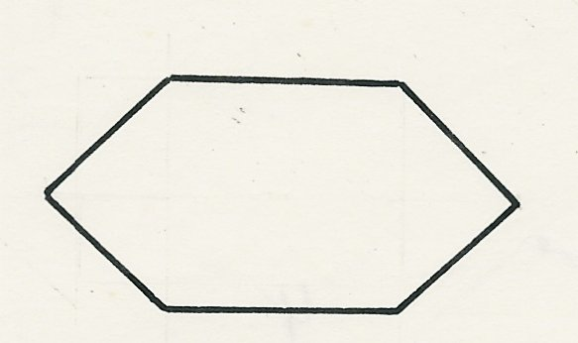
monosaccharide
Also called simple sugar, it can not be further hydrolysed to simpler chemical compounds; the simplest group of carbohydrates.
Monosaccharides are the building blocks/ monomers of disaccharides and polysaccharides.
Glucose is one example of monosaccharide. Chemical formula: C₆H₁₂O₆
H
C
O
HO
C
H
HO
C
H
H
C
OH
C
H
C
OH
C
O
C
C
H
C
OH
C
C
H
5 of the carbon atoms may
be arranged in a ring
This molecule is often represented simply as a hexagon
A glucose molecule as a straight chain

Slide 5
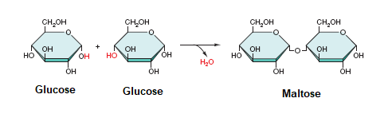
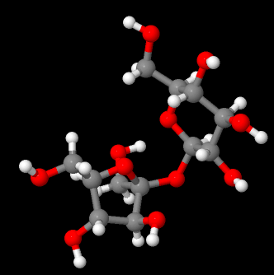
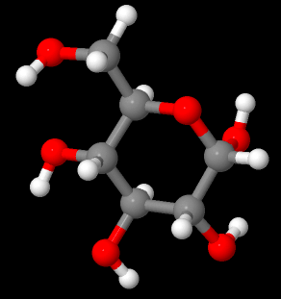
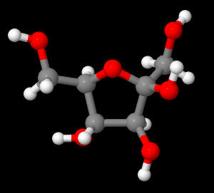
Disaccharide
Disaccharide, made of two monosaccharides joined together. E.g. sucrose (glucose + fructose), maltose (glucose + glucose), lactose
Glucose, C₆H₁₂O₆
Fructose, C₆H₁₂O₆

Slide 6
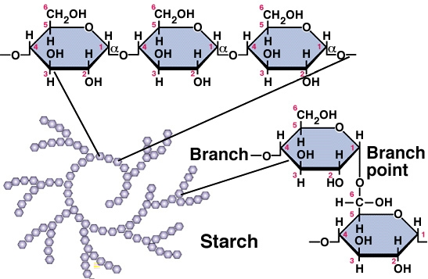
Polysaccharides
Made of many monosaccharides joining together.
E.g. starch, glycogen, cellulose

Slide 7

Biopolymer
Biopolymers are natural polymers produced by the cells of living organisms. Biopolymers consist of monomeric units that are covalently bonded to form larger molecules.
There are three main classes of biopolymers, classified according to the monomers used and the structure of the biopolymer formed: polynucleotides, polypeptides, and polysaccharides.
Polynucleotides, such as RNA and DNA, are long polymers composed of 13 or more nucleotide monomers.
Polypeptides and proteins, are polymers of amino acids and some major examples include collagen, actin, and fibrin.
Polysaccharides are linear or branched polymeric carbohydrates and examples include starch, cellulose and alginate.
Other examples of biopolymers include natural rubbers (polymers of isoprene), suberin and lignin (complex polyphenolic polymers), cutin and cutan (complex polymers of long-chain fatty acids) and melanin.

Slide 8
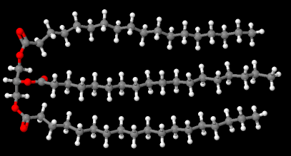
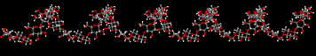
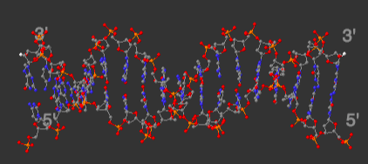
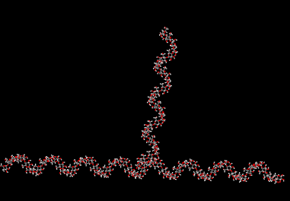
Triglyceride/ fat, can be broken down into 1 glycerol + 3 fatty acids
Starch- amylose & amylopectin
DNA

Slide 9
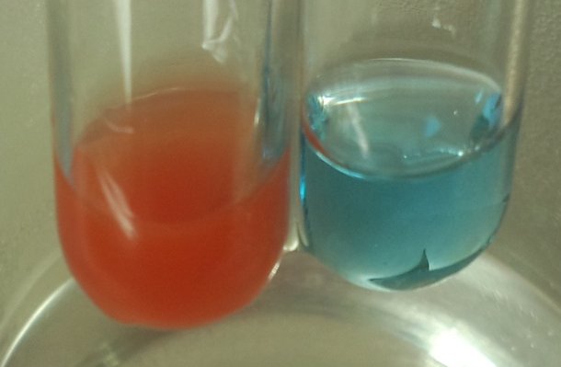
Testing for carbohydrates
1. Glucose- Reducing sugar.
Put the test solution into a test tube.
Add an excess of Benedict’s reagent.
Heat in a boiling water bath.
If glucose is present (positive result), the colour will change from blue to (green, yellow, orange) brick-red.
If glucose is not present (negative result) the solution will remain blue.

Slide 10
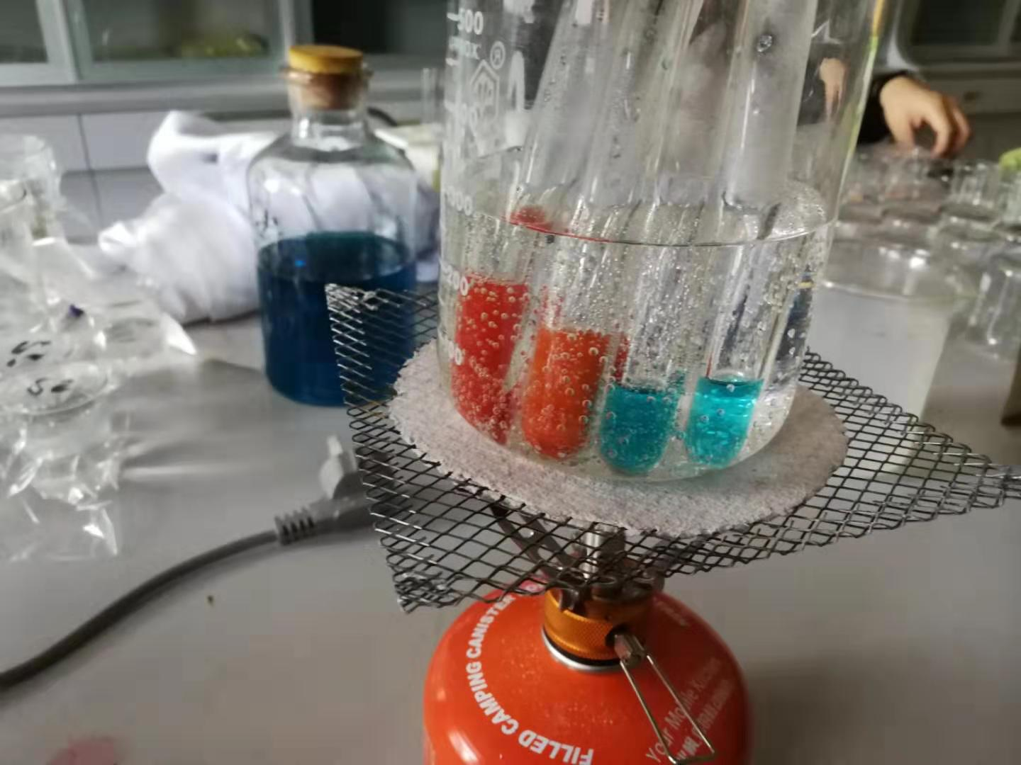
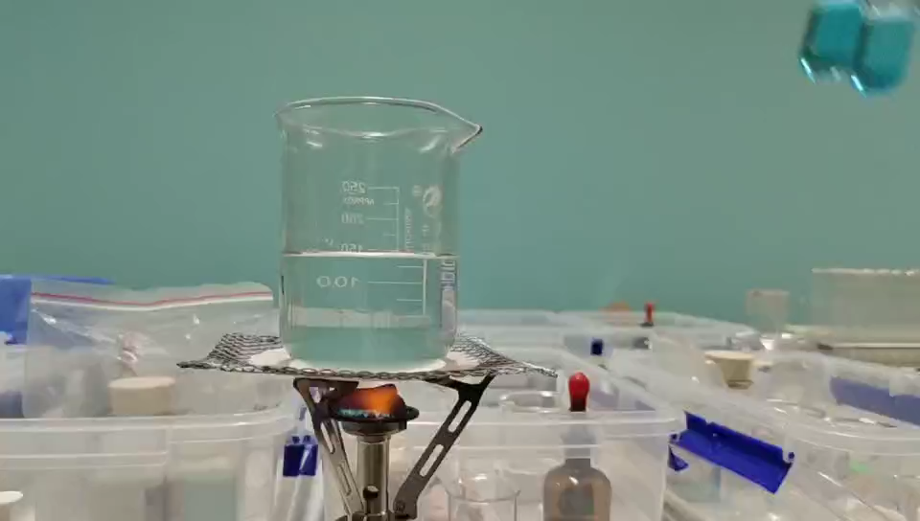
Benedict’s test
H₂ + O₂
H₂O
A reducing sugar can reduce some other chemicals, like Cu2+, to Cu₂O (brick red, insoluble)
(redox reaction) Take this reaction as an example.
Reductant (H₂) can reduce an oxidant(O₂), while an oxidant can oxidize a reductant.
Oxidation number/ valence of H element increase (from 0 to +1), H lose electrons, H has been oxidized.

Slide 11
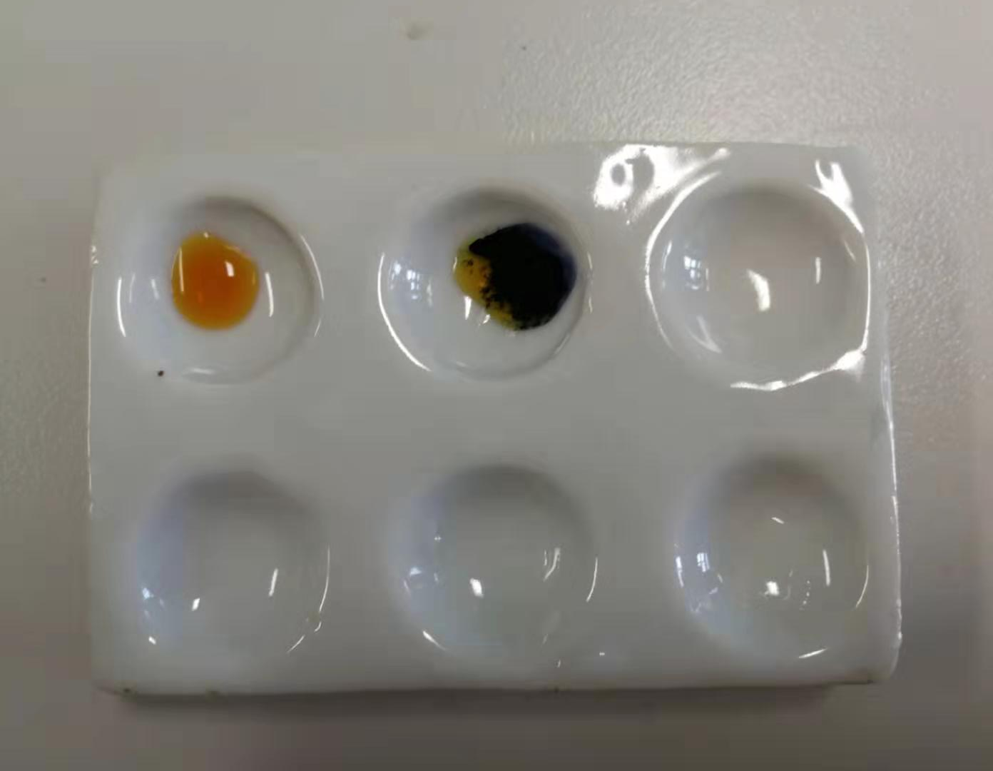
Testing for carbohydrates
Starch.
Put the test solution into a test tube/ spotting tile.
Add a few drops of iodine solution.
If starch is present, the colour will change from brown to blue-black.
If starch is not present the solution will remain/ stay brown.

Slide 12
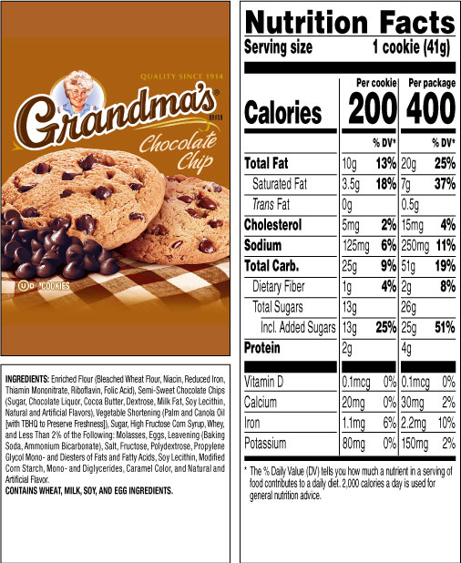
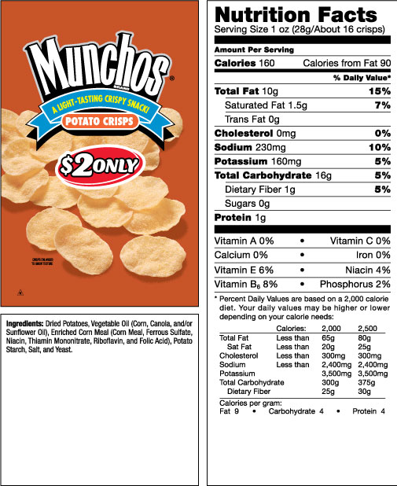
Nutrition facts

Slide 13
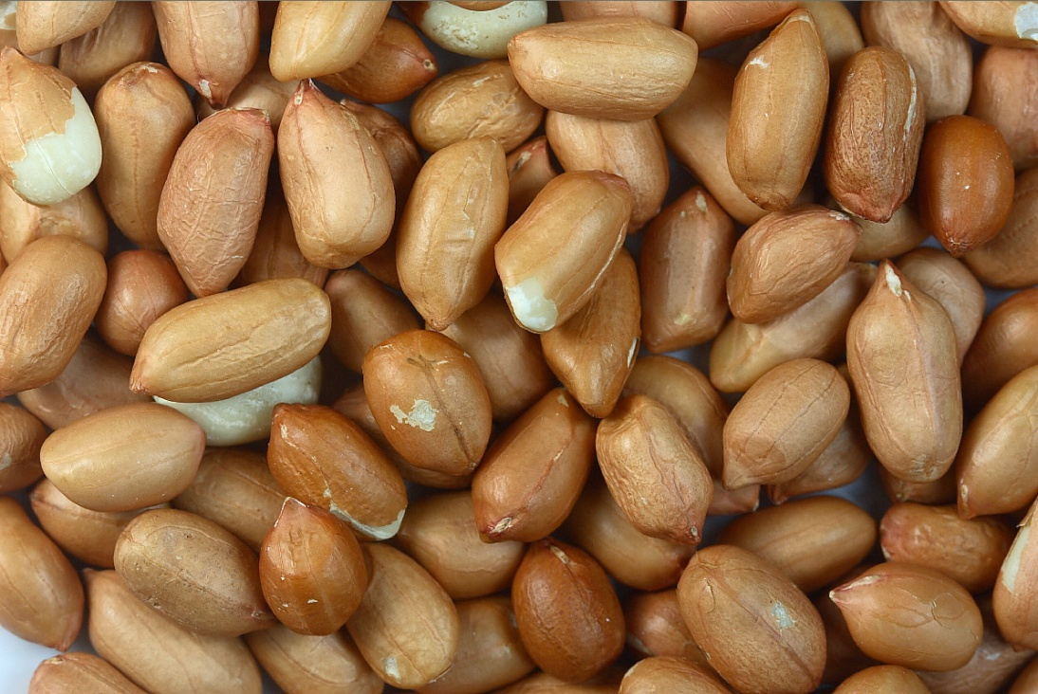
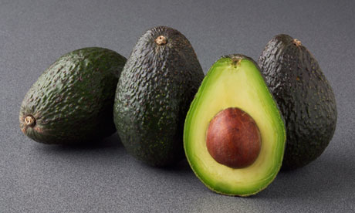
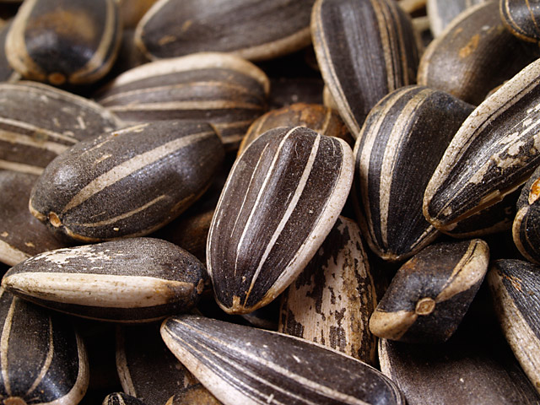
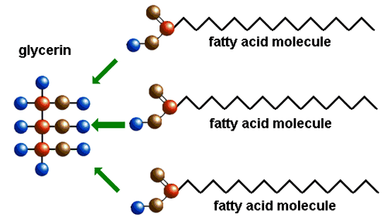
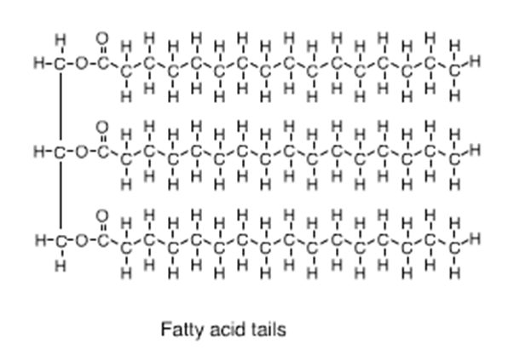
Fats
glycerol

Slide 14
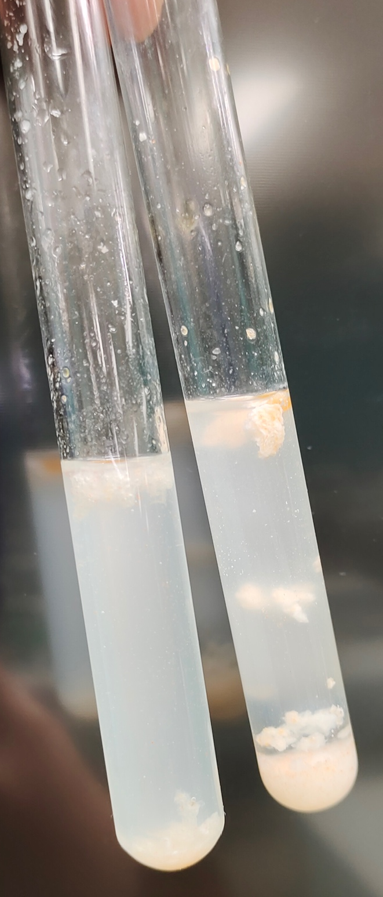
Testing for fats
Put the test solution into a test tube.
Add some ethanol and shake the tube.
Pour some distilled water into the test tube.
If fat is present, a white, milky emulsion will be formed.

Slide 15
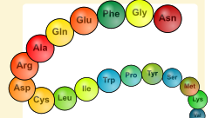
Proteins
Proteins are large molecules that are made from smaller molecules called amino acids.
There are 20 different amino acids found in organisms.
The order/ sequence of amino acids is very important in a protein.

Slide 16
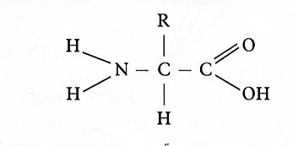
Amino acid
R group is the variable part between different amino acids.
Amino end
Carboxyl end
R
NH₂ - C - COOH
H
alkaline Amino group (-NH₂)
an acid Carboxyl group (-COOH)

Slide 17
Proteins
Some proteins are soluble in water, e.g. haemoglobin.
Others are insoluble in water, e.g. keratin.
Proteins are not used for energy, but they are needed for making new cells which are used in growth and repair.
Proteins are also needed to make antibodies, which help to protect against diseases.
enzymes
hormones – e.g. insulin

Slide 18
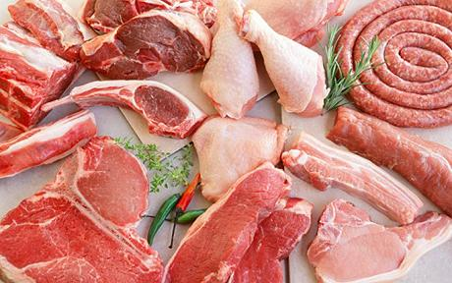
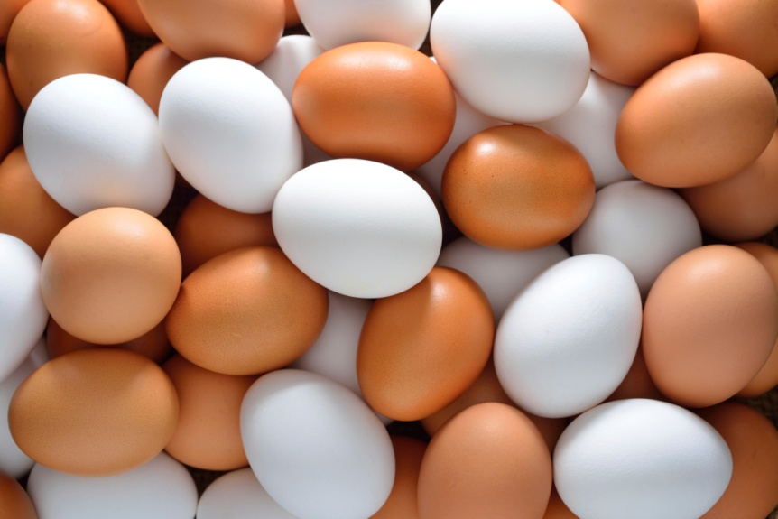
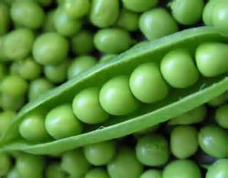
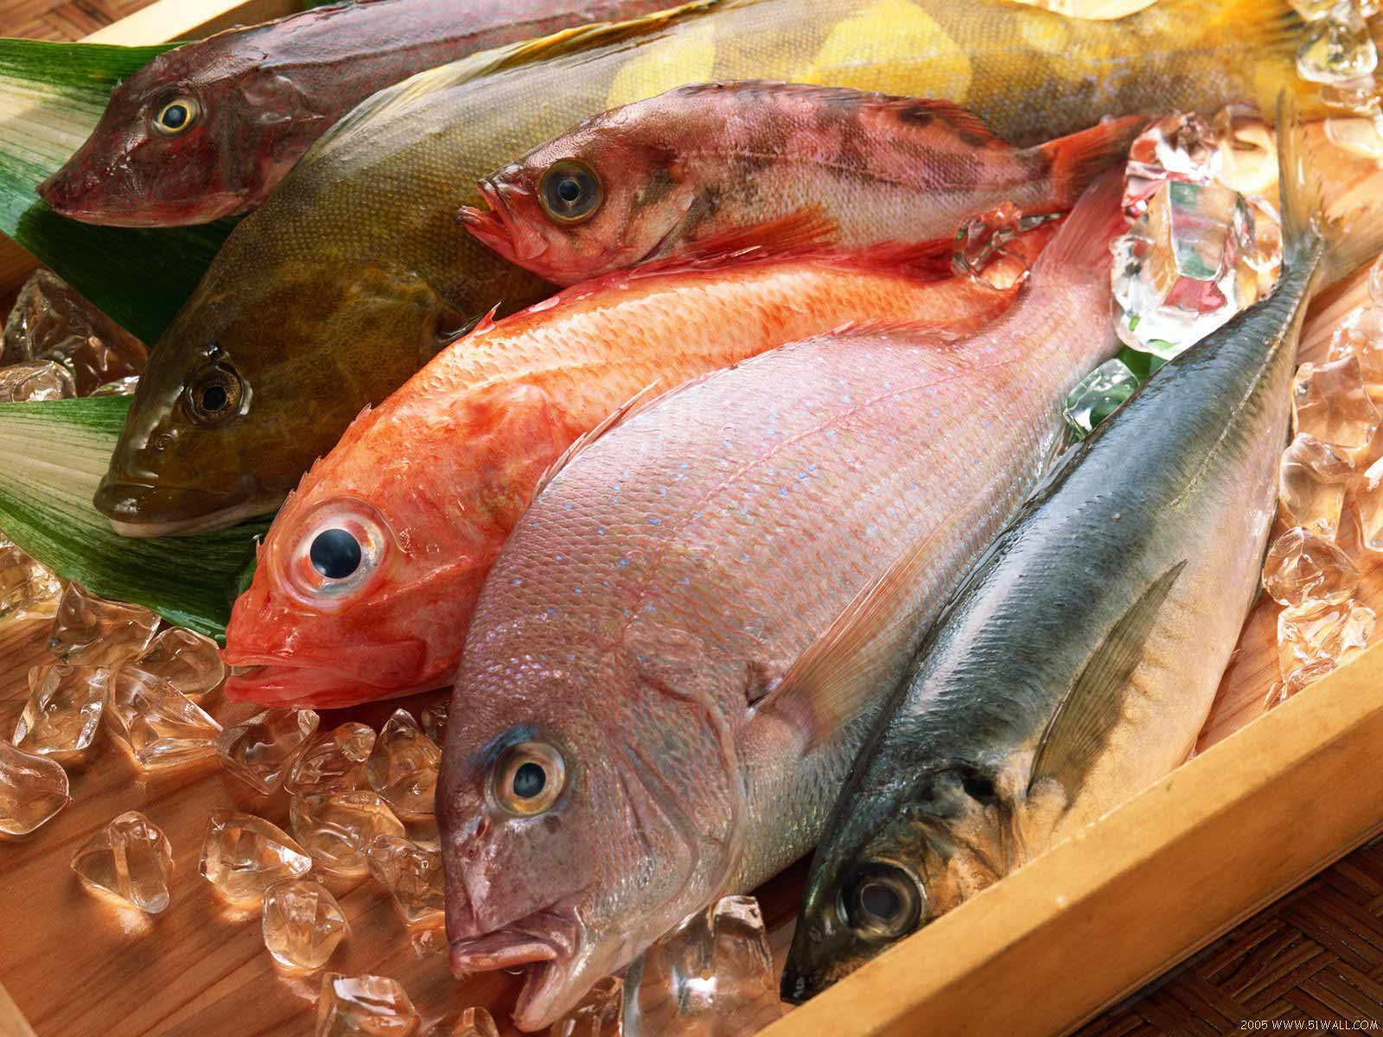
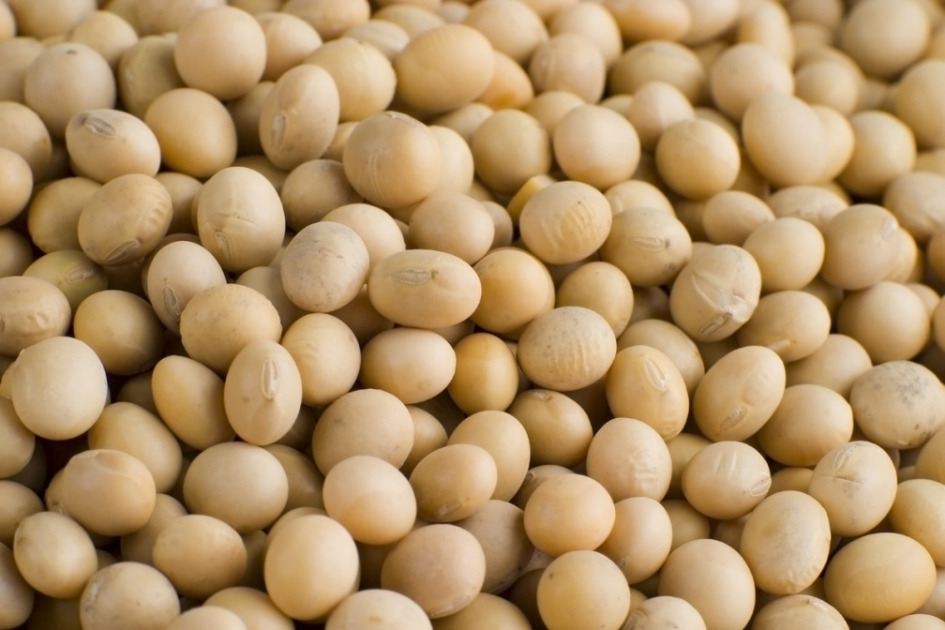

Slide 19
Testing for Proteins
Put the test solution into a test tube.
Add a Biuret reagent (potassium hydroxide solution plus copper sulphate solution).
If protein is present, the colour will change from blue to purple.
If protein is not present the solution will remain blue.

Slide 20
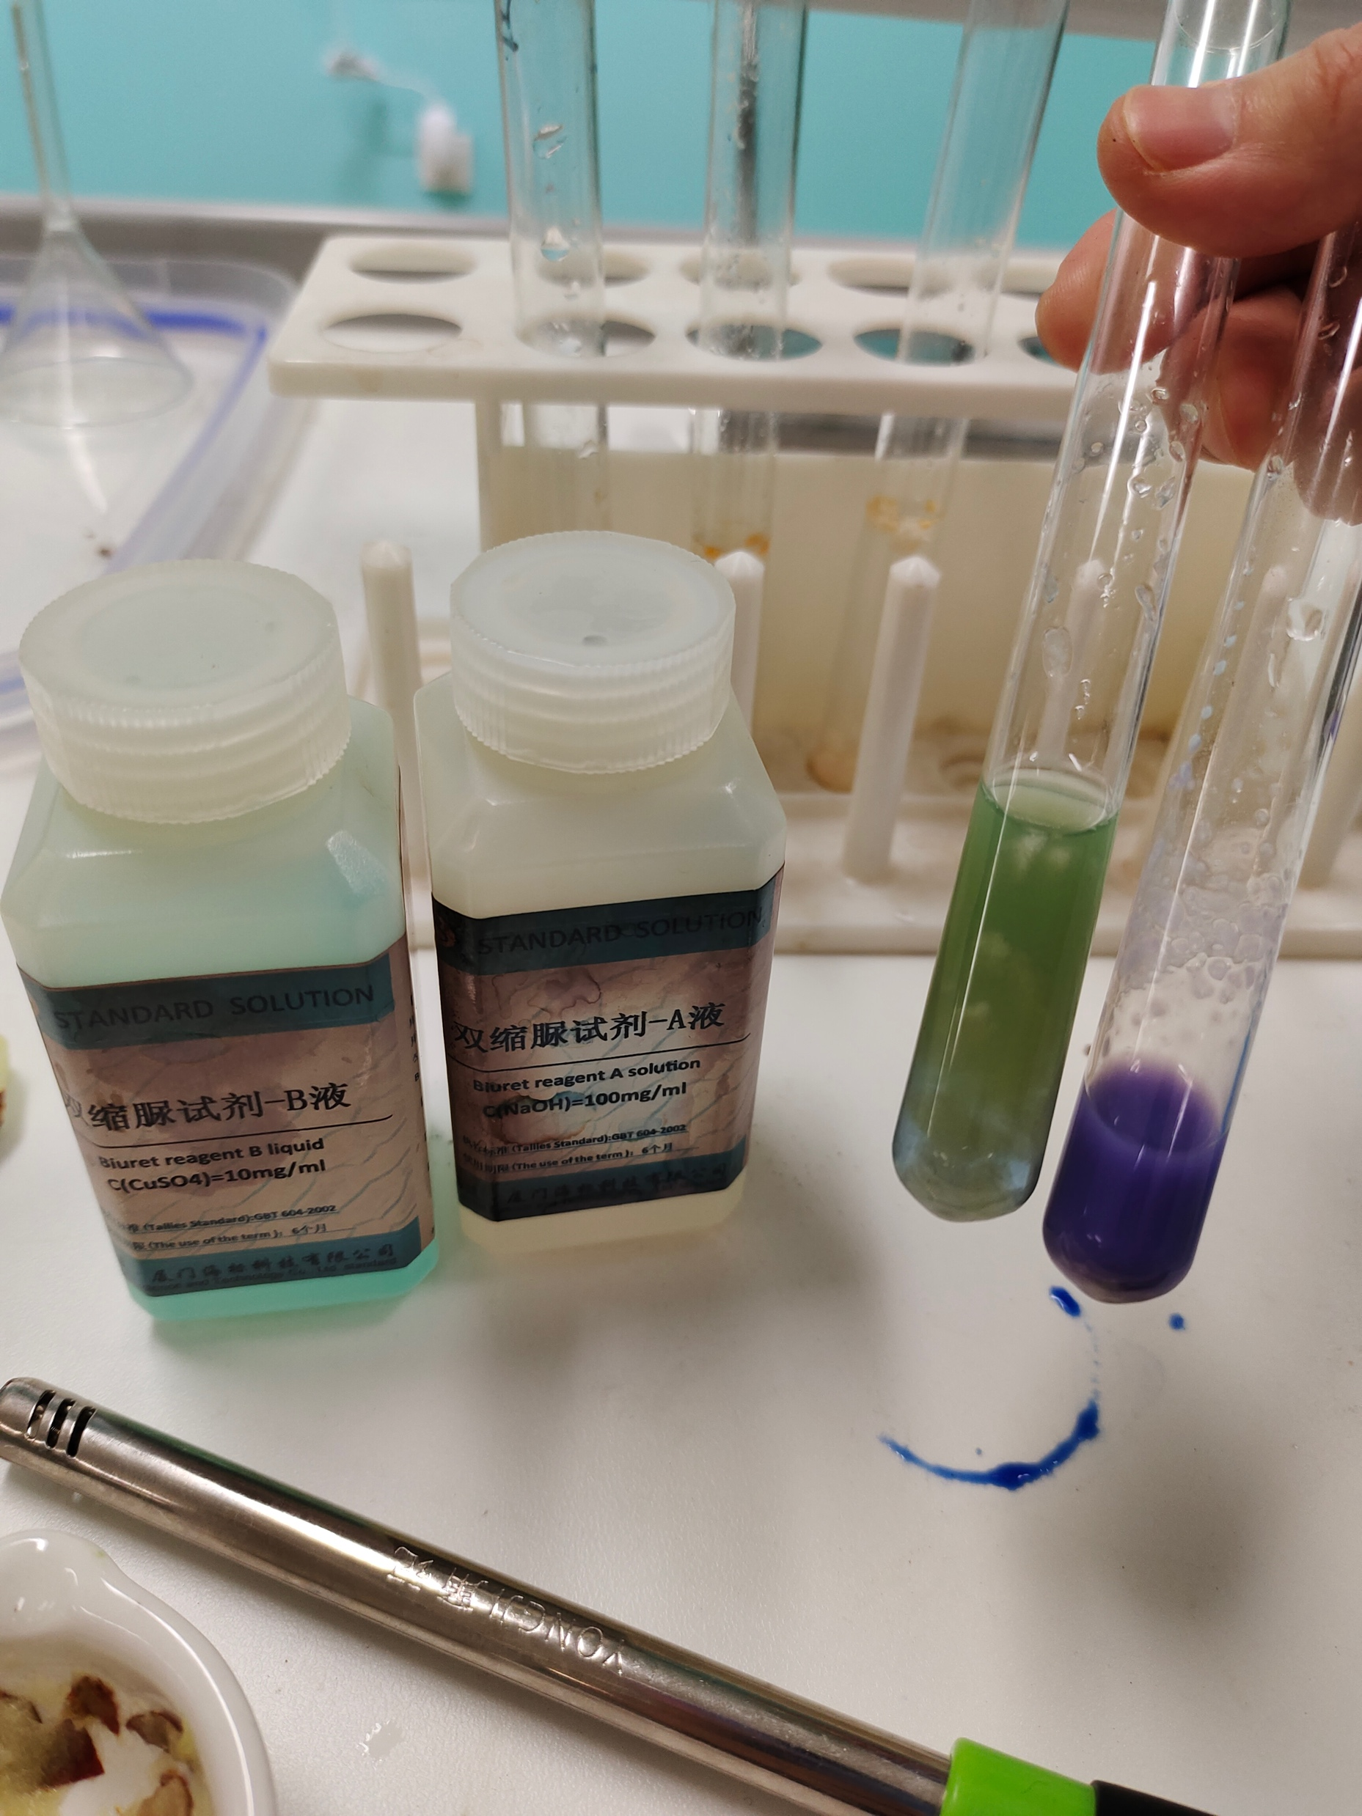
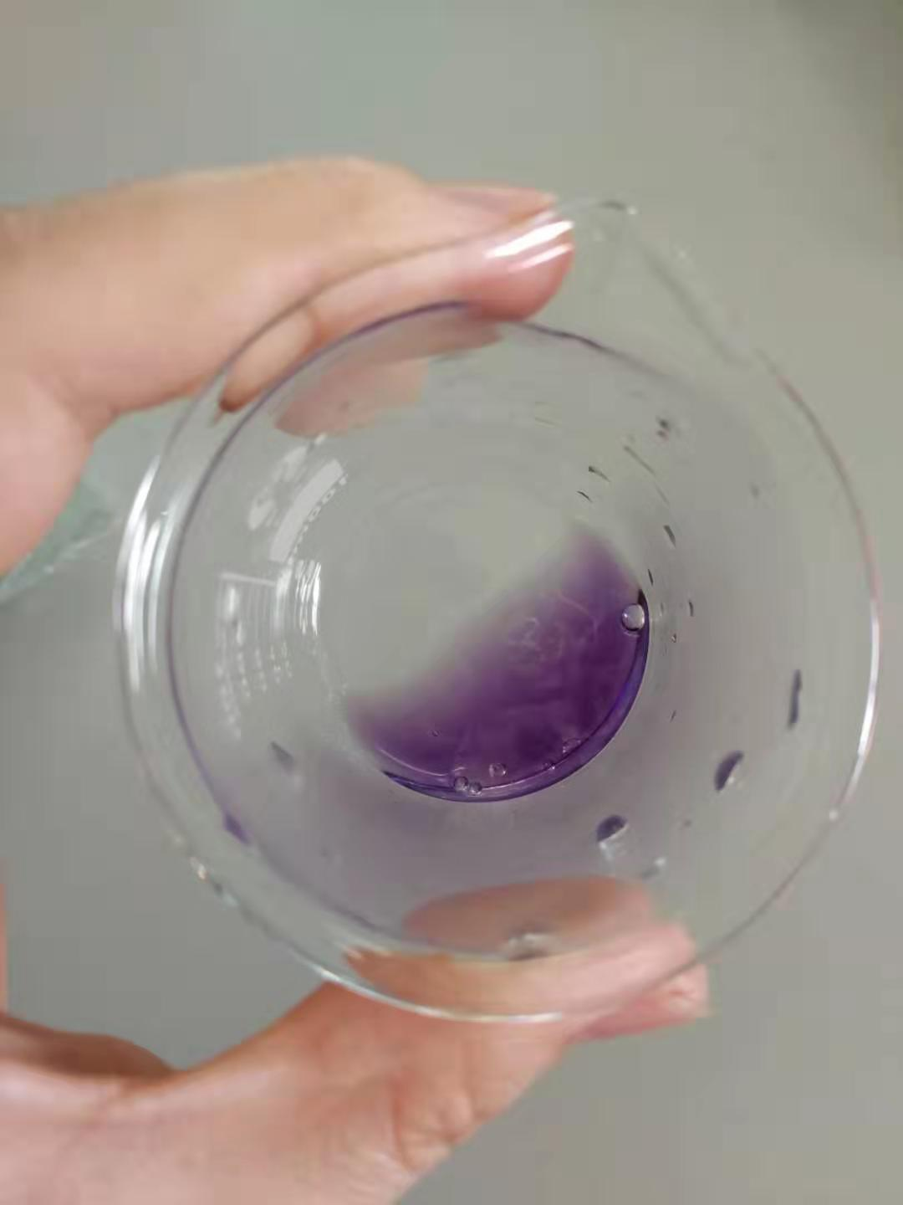
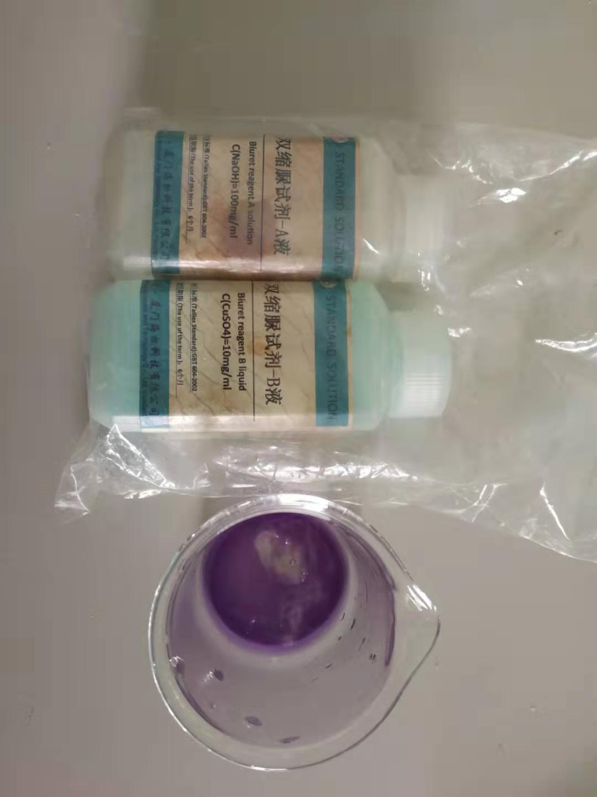
Biuret A: 0.1g/ml NaOH/KOH solution
Biuret B: 0.01g/ml CuSO₄ solution

Slide 21
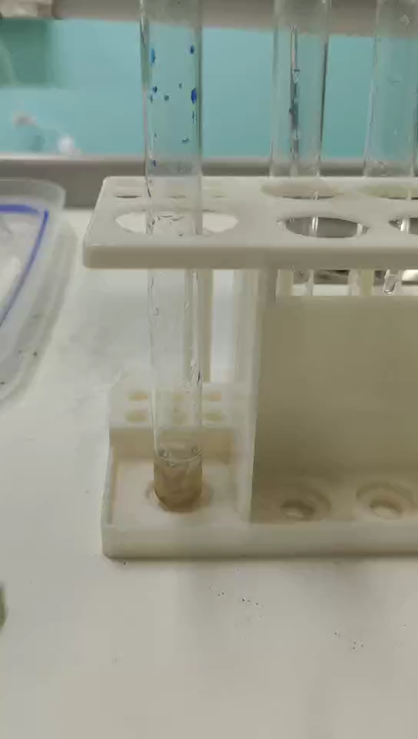
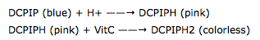
Test for Vitamin C
DCPIP: (Dichlorophenolindophenol)
DCPIP can be used as an indicator for Vitamin C.
If vitamin C, which is a good reducing agent, is present, the blue dye, which turns pink in acid conditions, is reduced to a colorless compound by ascorbic acid.

Slide 22
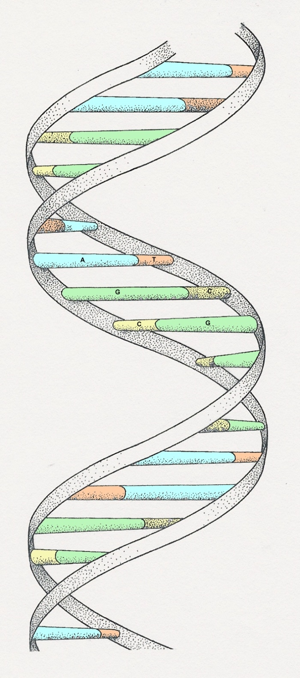
DNA
deoxyribonucleic acid

Slide 23
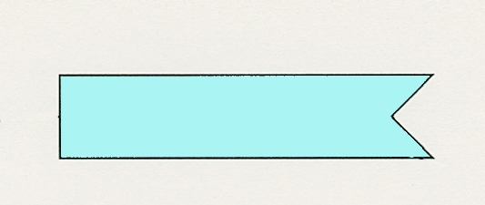
Nucleotides
The deoxyribose (5-C sugar), the phosphate and nitrogenous bases (abbreviated as A, T, C, G) combine to form a nucleotide, which is the monomeric unit of nucleic acids (DNA).
PO₄
A (adenine)
deoxyribose
Notes:
It is the phosphate group which gives DNA its acidic properties

Slide 24
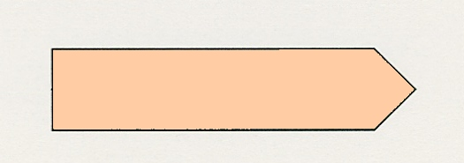
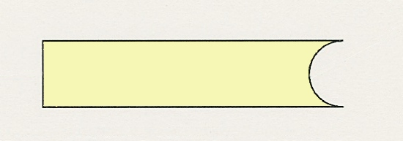
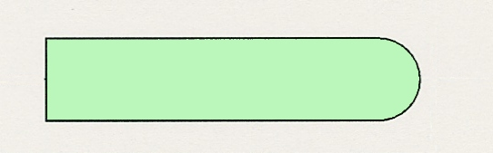
The bases
The 4 organic bases found in DNA are:
Adenine
(A)
Thymine
(T)
Cytosine
(C)
Guanine
(G)

Slide 25
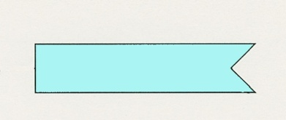
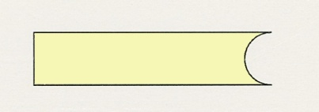
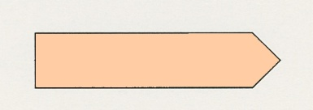

Nucleotides joined together like this.
PO₄
PO₄
PO₄
PO₄
sugar-phosphate
backbone
+ bases

Slide 26

















2-stranded DNA
Strand 1
Strand 2
PO₄
PO₄
PO₄
PO₄
PO₄
PO₄
PO₄
PO₄
Double helix
PO₄
PO₄
PO₄
PO₄
PO₄
PO₄
PO₄
PO₄
--C-C-G-C-A-G-C-T-G-T-C-A-A-T-T-C-T-C-T-C-C-G-G-A-T-C-C-A

